Slide 1
Ship It Good
Deploying ASP.NET Core Like a Pro

Slide 2


Where We Came From
Compilation
MSBuild/CodeDOM > csc.exe
Libraries
Loose, GAC, NuGet
Application Frameworks
FCL, GAC, NuGet
Web Server
IIS
Platform Libraries
.NET BCL and FCL
Runtime
.NET CLR
Runtime Loader
IIS: WebEngine4.dll; EXE: OS
Operating System
Windows

Slide 3
Why .NET Core Changes Everything?
MSBuild/CodeDOM > csc.exe
Compilation
.Net CLI (Roslyn)
Loose, GAC, NuGet
Libraries
NuGet, npm
FCL, GAC, NuGet
Application Frameworks
NuGet
IIS
Web Server
IIS, HTTP.SYS, Kestrel
.NET BCL and FCL
Platform Libraries
.NET BCL and FCL; .NET on NuGet
.NET CLR
Runtime
.NET CLR; .NET Core CLR
IIS: WebEngine4.dll; EXE: OS
Runtime Loader
.Net CLI
Windows
Operating System
Windows, OSX, Linux

Slide 4
First, We Must Build

Slide 5
Building with Tools

Slide 6
But I Hate IDEs!!!

Slide 7
Then We Will Deploy

Slide 8
Deployment Options .NET
Framework-dependent Deployment (FDD)
Self-contained Deployment (SCD)
Framework-dependent executables (FDE)
Self-contained executable (New with .NET Core 3.0)

Slide 9
Framework-dependent Deployment (FDD)

Slide 10
Self-contained Deployment (SCD)

Slide 11
Framework-dependent executables (FDE)

Slide 12
Self-contained executable

Slide 13
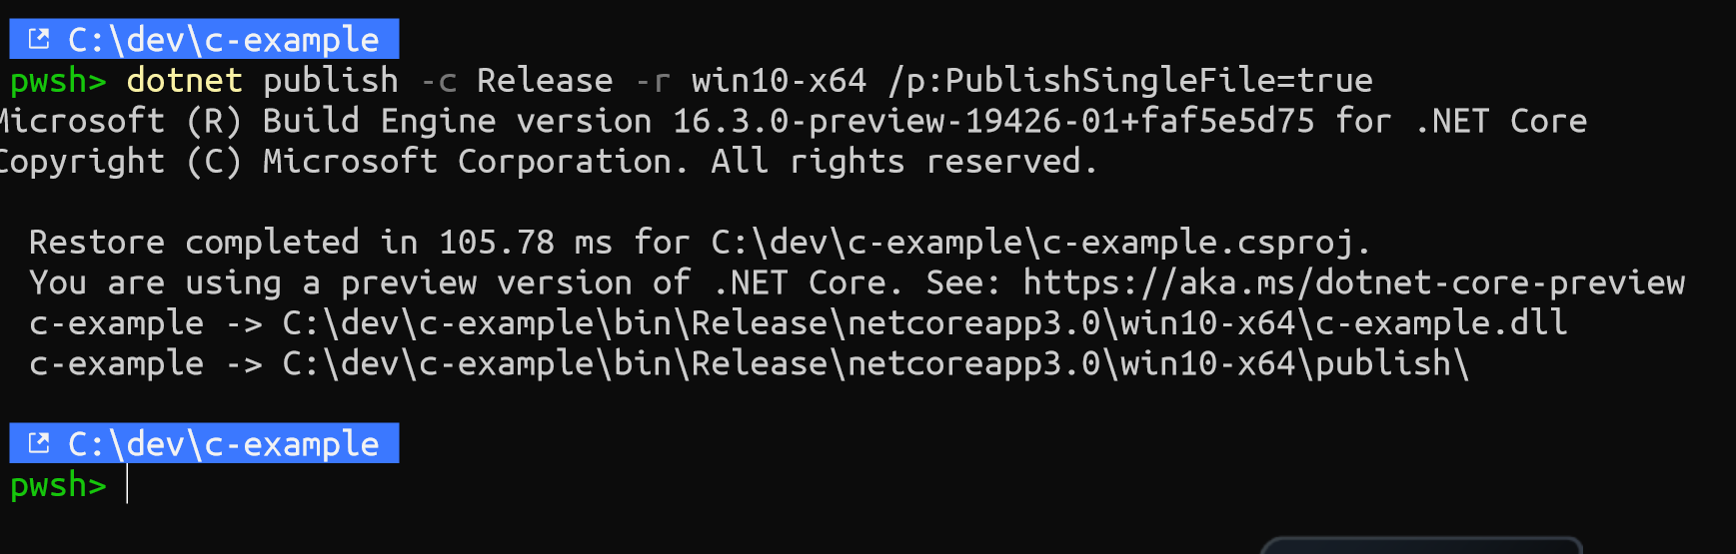
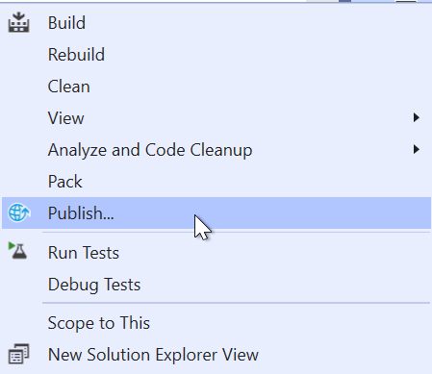
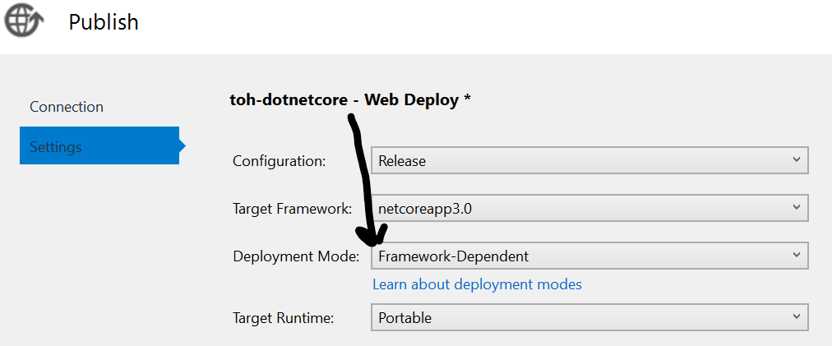
Getting Code off My Machine
Using Some IDE
Using the CLI

Slide 14
Let’s Build & Publish Some Code!

Slide 15
I Guess We Have to Talk DevOps

Slide 16

Why Publishing from VS Fails?
You May Have Code Others Don’t
You May Have something on your machine others don’t
You May Have Not Run Tests
See a Trend Here?

Slide 17
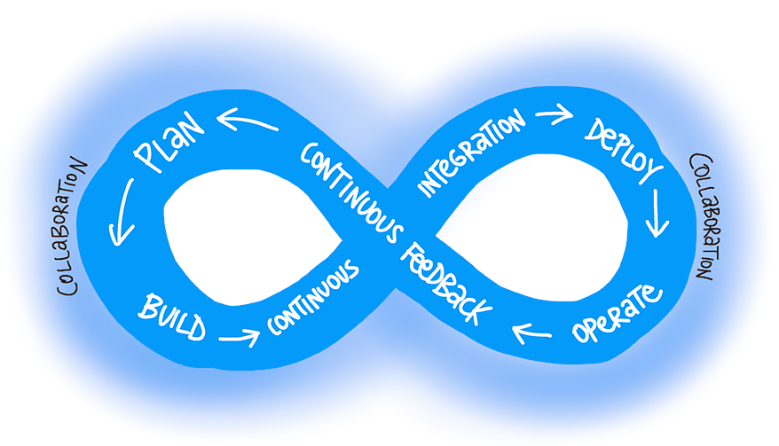
Ok, So What is THE Better Option?

Slide 18
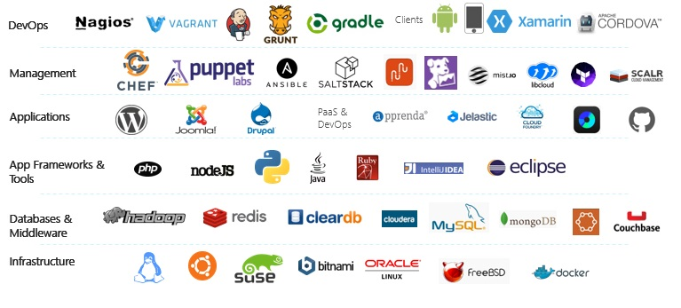
What Tools Can I Use?
Tools that are aligned with DevOps…. Waaaaaay too many

Slide 19

What Tools Can I Use?
Tools that are aligned with DevOps…. Waaaaaay too many

Slide 20
Azure Pipelines, CI/CD Made Simple
Any language/any platform
Can build code base from Azure Repos, GitHub, GitLab or Bitbucket
Configure builds/releases in YAML (config as code) or WYSIWYG Editor
Use build agents hosted by Microsoft or bring your own
Full control over what code goes where through Azure DevOps Portal

Slide 21
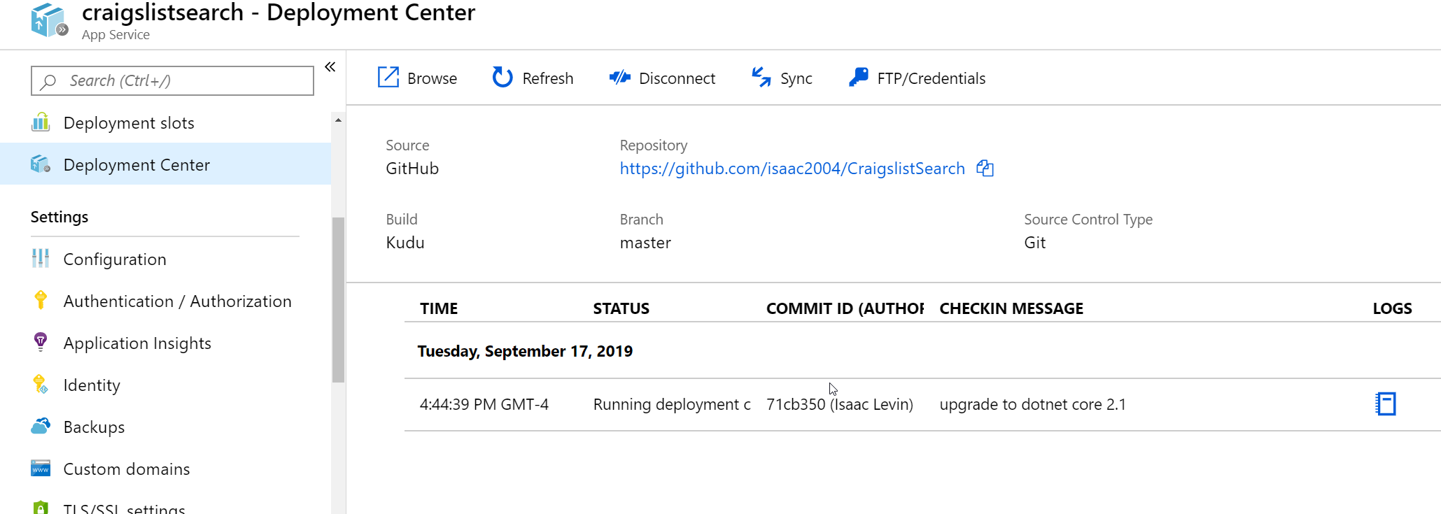
But I Want Something Easier!!!
Azure App Service Deployment Center
Configure your entire CI/CD through Azure Portal

Slide 22
Rub Some DevOps on it ©Donovan Brown

Slide 23
Questions?

